Slide 1
XG Boost Algorithm

Slide 2
Definition Of XG Boost:
XG Boost, short for "Extreme Gradient Boosting," is a machine learning algorithm that belongs to the family of boosting algorithms. Boosting is an ensemble learning technique where multiple weak models, typically decision trees, are combined to create a stronger predictive model.

Slide 3
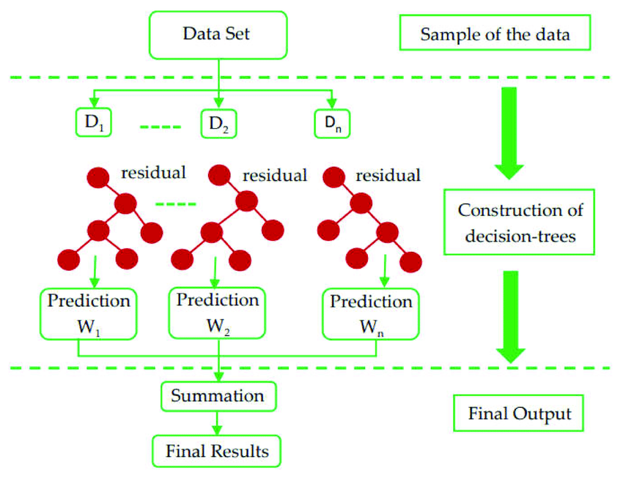

Slide 4
XG Boost:
Same as Gradient Boosting but has Additional Functionality
Distributed Machine Learning Process
More Computational Speed and Model Efficiency
Gradient Boosting Sequentially Slow

Slide 5
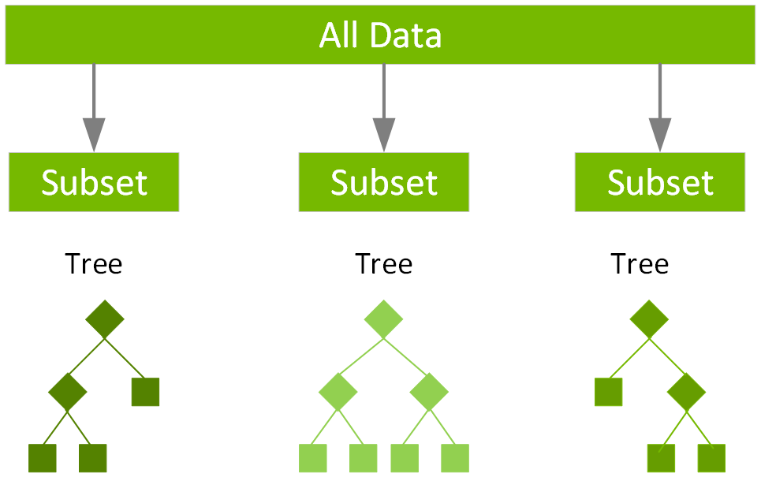
Key Points:
Weak Learners
Objective Function
Gradient Optimization
Regularization
Parallelization

Slide 6
Overall:
XGBoost is a powerful and widely used algorithm known for its excellent performance in various machine learning tasks, including regression, classification, and ranking problems. It has become a popular choice among data scientists and practitioners due to its versatility, speed, and ability to handle large datasets effectively.

